Slide 1

School of Computer Science & IT
Jayanagar 9th Block Campus, Bangalore
Department Of BCA
A presentation on
Mobile Database Management

Slide 2
NO | Topic
1. | Overview and objective
2. | Introduction
3. | System Specifications
4. | Screen shots
5. | Project demo
6. | Conclusion

Slide 3
1.OVERVIEW AND OBJECTIVE
This ‘Mobile Database Management Project’ has been designed taking into account the practical needs to manage the details of the mobile devices launched in the market. It has been developed to override the problems of customers and mobile store managers. A customer can find the list of phones available in the market through the smooth and easy to operate graphical interface provided in the application. This project is designed to ease the work of store managers, who can maintain an accurate record of the available mobile phones that are available in their store
This mini project is developed to give a basic idea of how to work with DBMS and Java Interface so as to understand the basics of Database System and storing and generating large amount of data easily and efficiently.
This project is designed to take advantage of today's technology and reduce or avoid the burden of storing data on paper or in files. Our database management project aims to provide computerized interface to all the data stored and manipulated. The application provides for retrieving, storing, modifying, maintaining and easy use of data.

Slide 4
2.INTRODUCTION
The mobile database has been designed taking into account the practical needs to manage the details of the mobile devices launched in the market. It has been designed for desktop systems. This software will provide a simple and easy to operate graphical interface which can be utilized by any user without the depth knowledge of technology. It provides security at product level as well as user level.
Through the Java Interface, the administrator can view and manipulate the records in the table.
The table consisting of different mobile records will be provided to the user and therefore they will have various options to choose from.
Once a new mobile record is added, the database will store the information of the mobile into the relation ‘mobile’.

Slide 5
3.SYSTEM SPECIFICATIONS
Hardware Requirements:
Intel or AMD processor
1 GB RAM
2GB Storage
Software Requirements:
Windows/MAC operating system
MySQL
Intellij for JAVA
Local Server (Xampp)

Slide 6
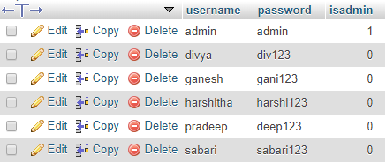
4.SCREEN SHOTS
Fig: Accounts Table

Slide 7
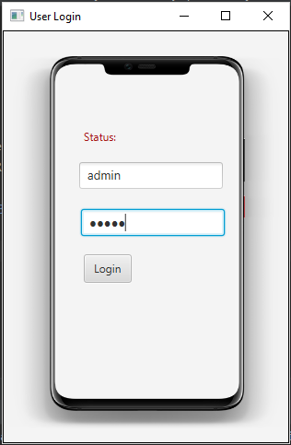
Fig: Login Interface

Slide 8
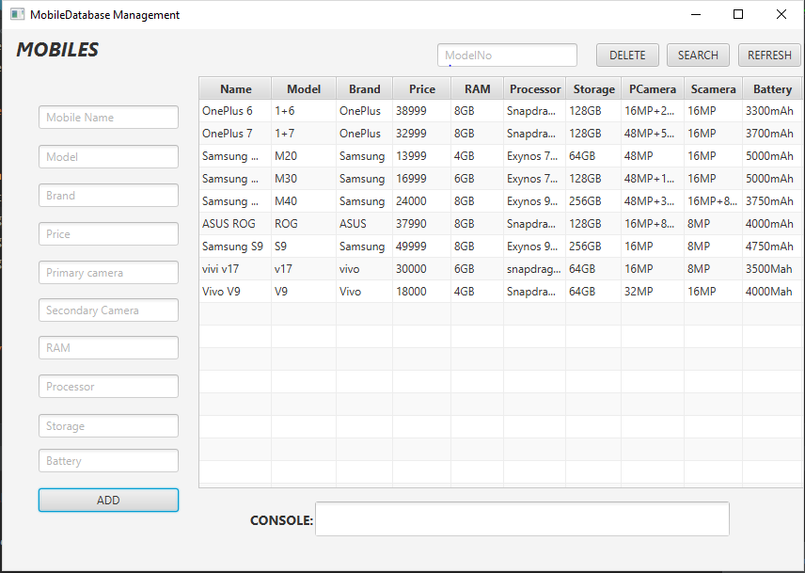
Admin User Interface

Slide 9
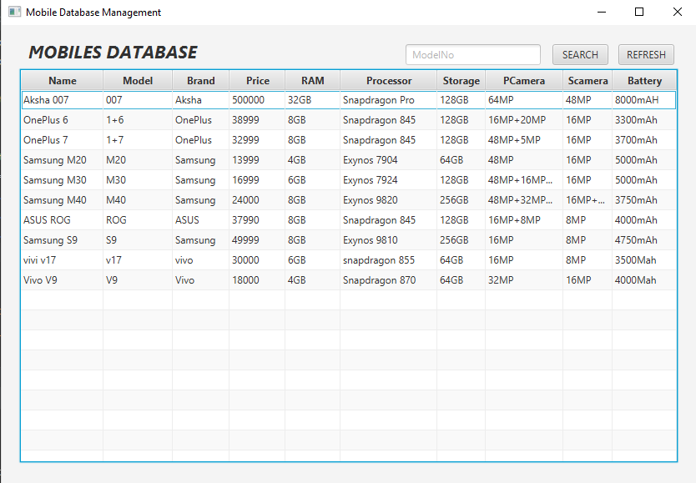
Fig: Standard User Interface

Slide 10
5.Project Demo

Slide 11
6.Conclusion
This mini project is to give a basic idea of how to work with DBMS and JAVA interface so as to understand the basics of Database System and storing and generating large amount of data easily and efficiently.
This project is designed to take advantage of today’s technology and reduce or avoid the burden of storing data on paper or in files. Our database management project aims to provide computerized interface to all the data stored and manipulated. The application provides for retrieving , storing, modifying, maintaining , and easy use of data

Slide 12
THANK YOU

